Slide 1
Software Engineering
Midterm Project 2024
Adrien CAPITAINE, Damien DUTHOU, Jason QIU,
Kelian DE FOURNIER DE BRESCIA, Nathan CHAMPAGNE

Slide 2
Table of contents
01
02
03
04
Our project
Demonstration
Reasons, features and explanation of the project
A presentation video of our application running
Progress overview
Backlog
Team contribution, problems and solutions
Possible future enhancements

Slide 3
Our project
Goal
A GUI for API request
Aims to make it easier for the user to make request to the given APIs
Help the user get to the right place with the right path.

Slide 4
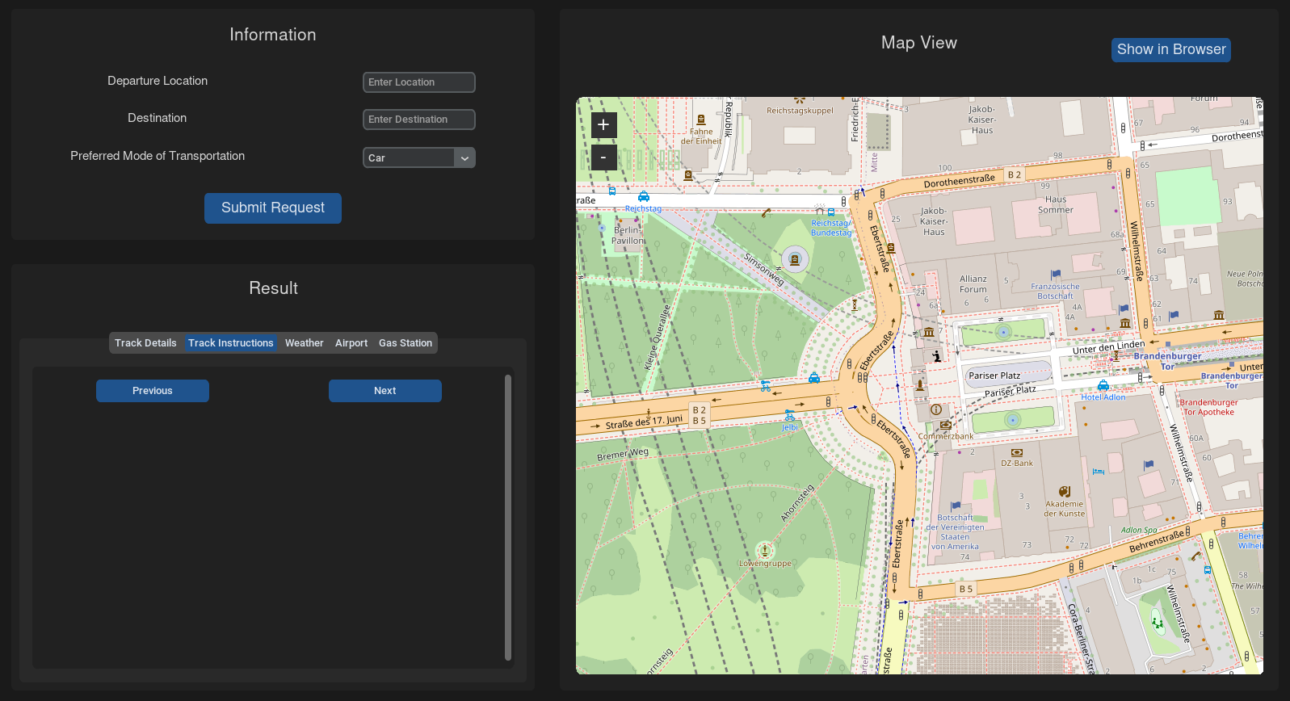
Our project
Main Interface
The UI is split in 3 distinct parts:
The input field
The map field
The result field

Slide 5
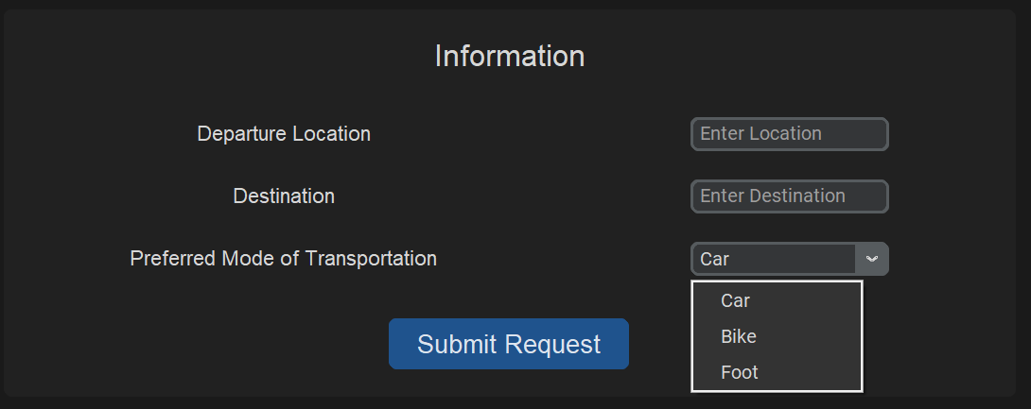
Our project
Input Interface
The user gets to input his data in the designated fields and submit a request by the press of a button.

Slide 6
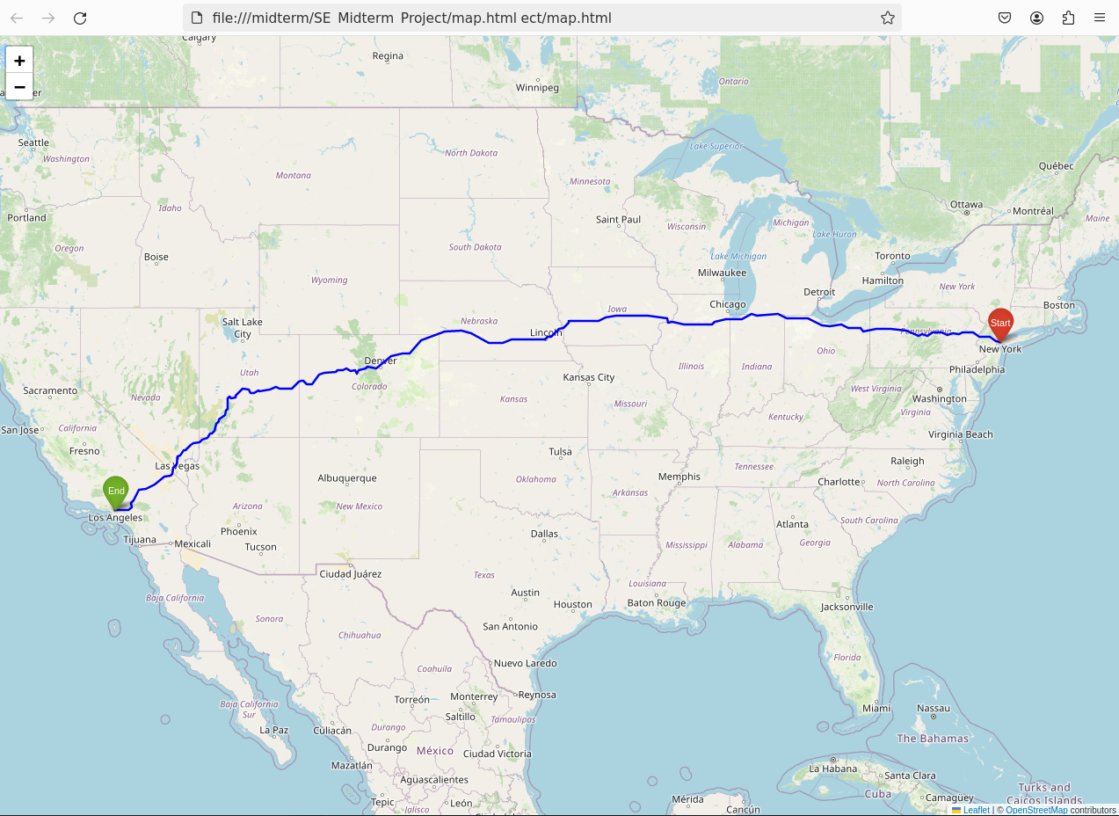
Our project
Result of the GraphHopper API
We chose to display the map directly in the application, with the option to open it in a web page.
The map is displayed with markers for departure and arrival (as well as markers for airports and gas stations) and the route.

Slide 7
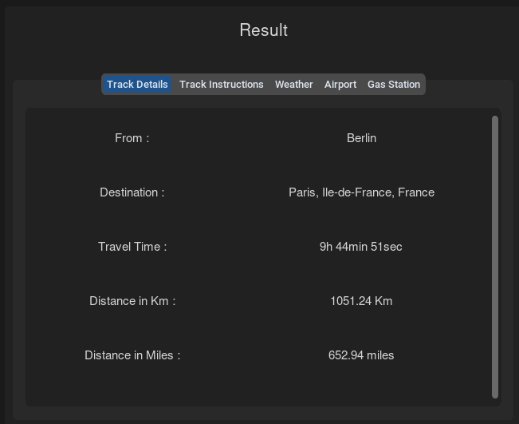
Our project
Result of the GraphHopper API
The GraphHopper API provides other information, such as the travel time (which depends on the means of transport), the distance in kilometres and the distance in miles.

Slide 8
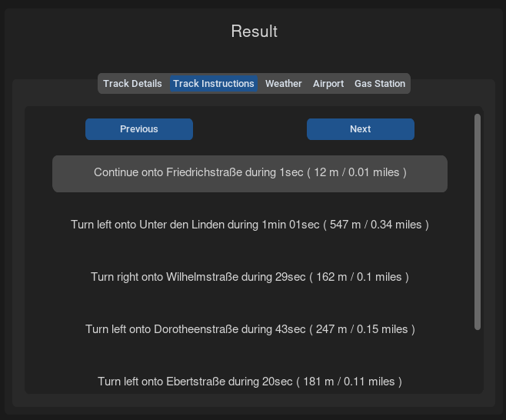
Our project
Result of the GraphHopper API
We also have instructions for the route, with the option of moving forward or backward in the list using the buttons above.

Slide 9
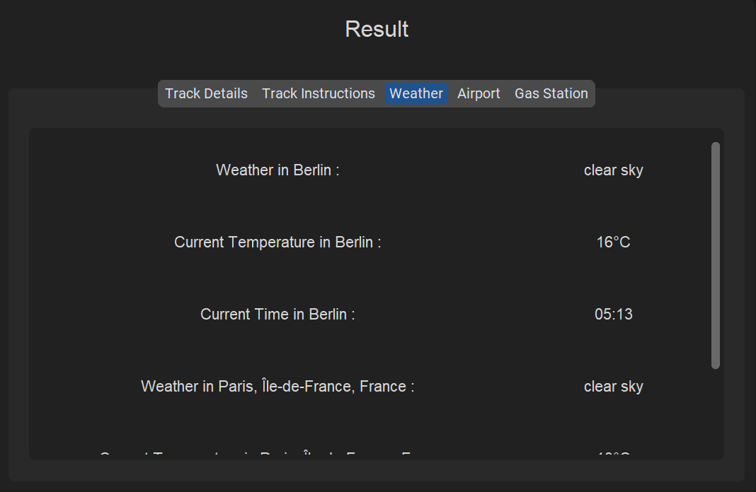
Our project
Weather and time
Displays the weather, the temperature and the current time at the departure point and destination
Uses OpenWeatherMap API
Link : https://openweathermap.org/
Information on the weather anywhere in the world, just with the geographic coordinates

Slide 10
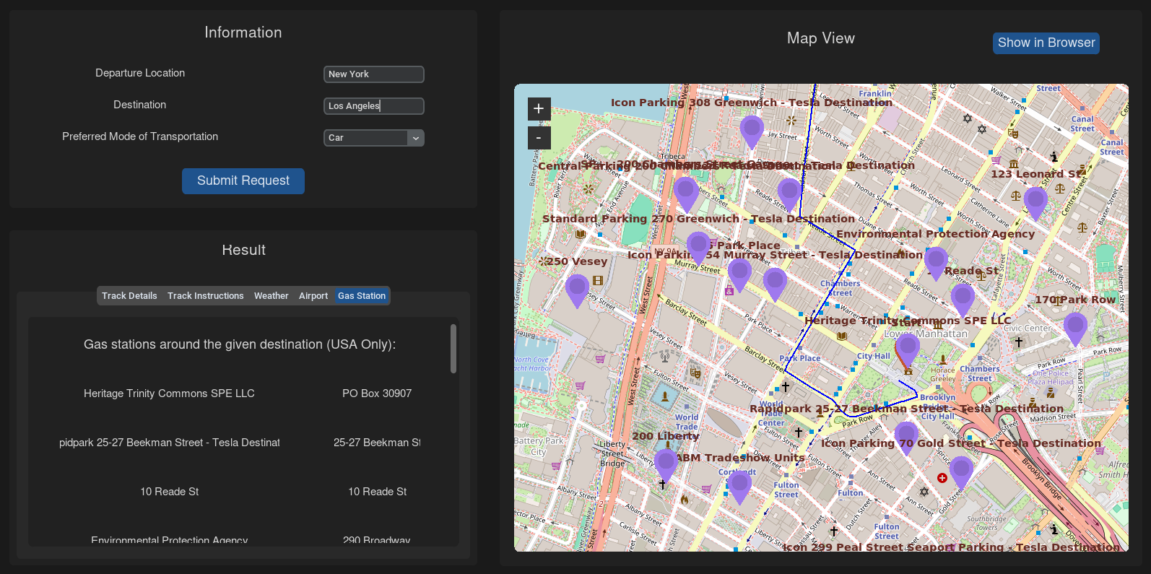
Our project
Gas Stations
Utilizing the National Renewable Energy Laboratory (NREL) API
Link: https://developer.nrel.gov/docs/transportation/alt-fuel-stations-v1/nearest/
Geographical Constraint: the United States

Slide 11
Our project
Gas Stations
Functionality:
Identifying stations within a 0.5 mile radius along ten specific points on the route
Comprehensive coverage and accessibility to alternative fuel stations
Visual Cue:
Purple markers on the map interface to highlight stations
Table Format: Display of Station Names and Addresses

Slide 12
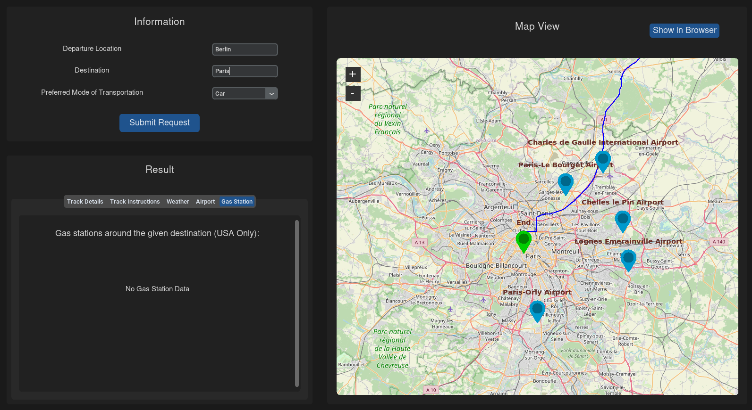
Our project
Airports API : Utilizing the Ninja API for Global Airport Display
Data Source:
Leveraging the API Ninjas for comprehensive airport data.
Selection Criteria:
Fetching airports within a 50-mile radius of the destination city's coordinates.
Ensuring specificity, crucial for cities sharing the same name.

Slide 13
Our project
Airport display
Visual Representation:
Airports depicted on the map via blue pins for intuitive navigation
Precision in Distance Calculation:
Implementing the Haversine formula for accurate distance calculations.
Accounts for Earth's curvature for precise results.

Slide 14
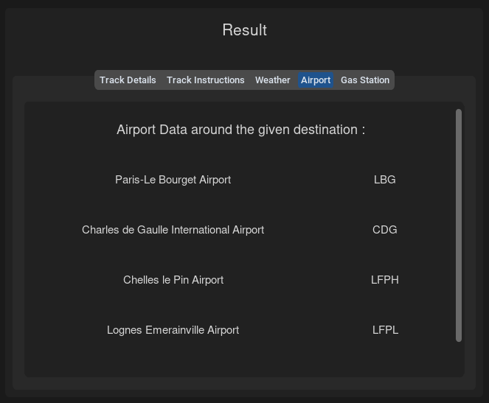
Our project
Airport display
Data Presentation:
Presented in a tabular format for easy reference.
Includes airport names and respective IATA codes (if available).
ICAO codes utilized when IATA codes are unavailable.

Slide 15
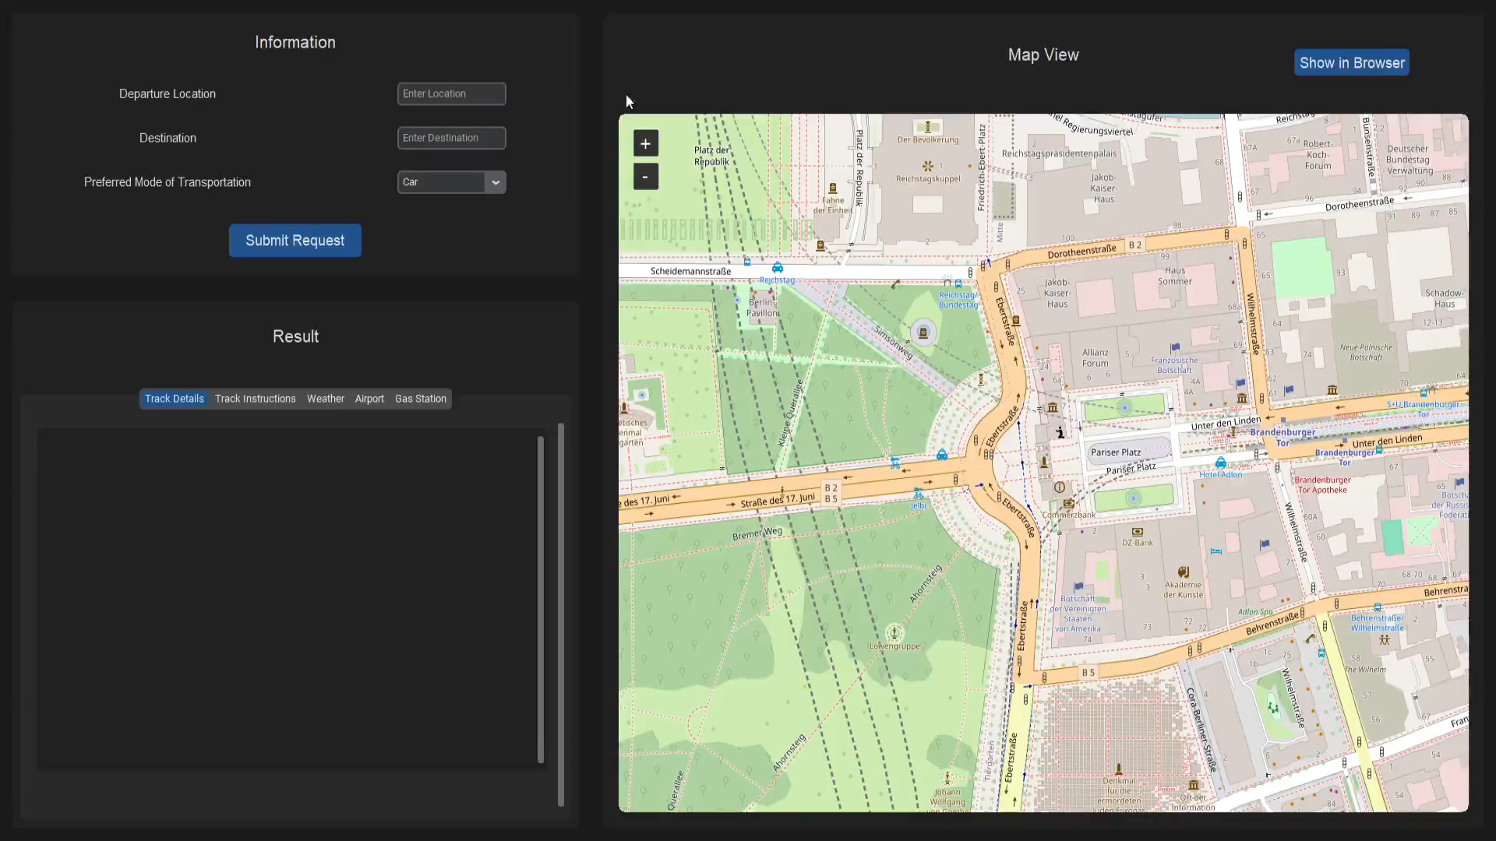
Demonstration
YouTube Video

Slide 16

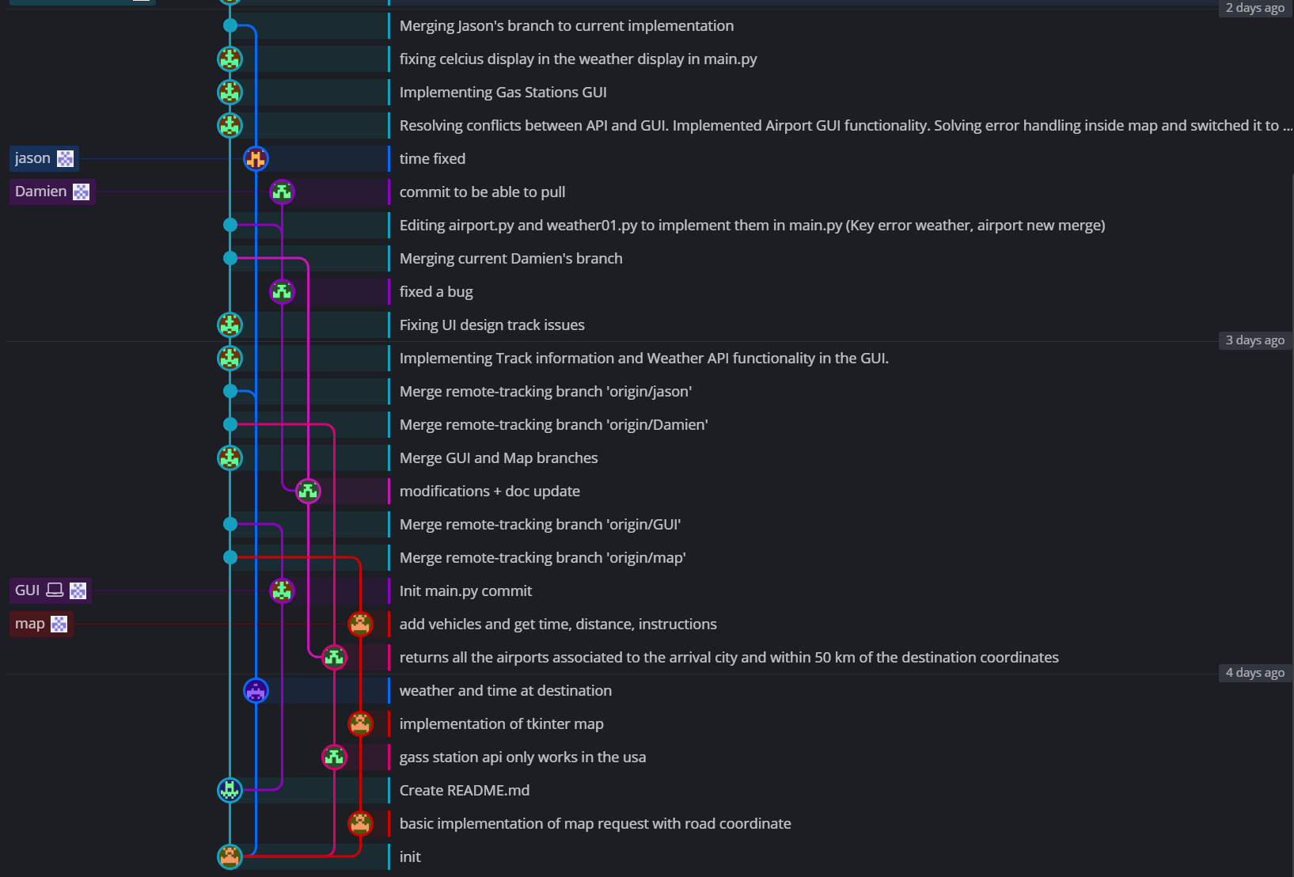
Progress Overview
Git visualisation of our branches and merges

Slide 17
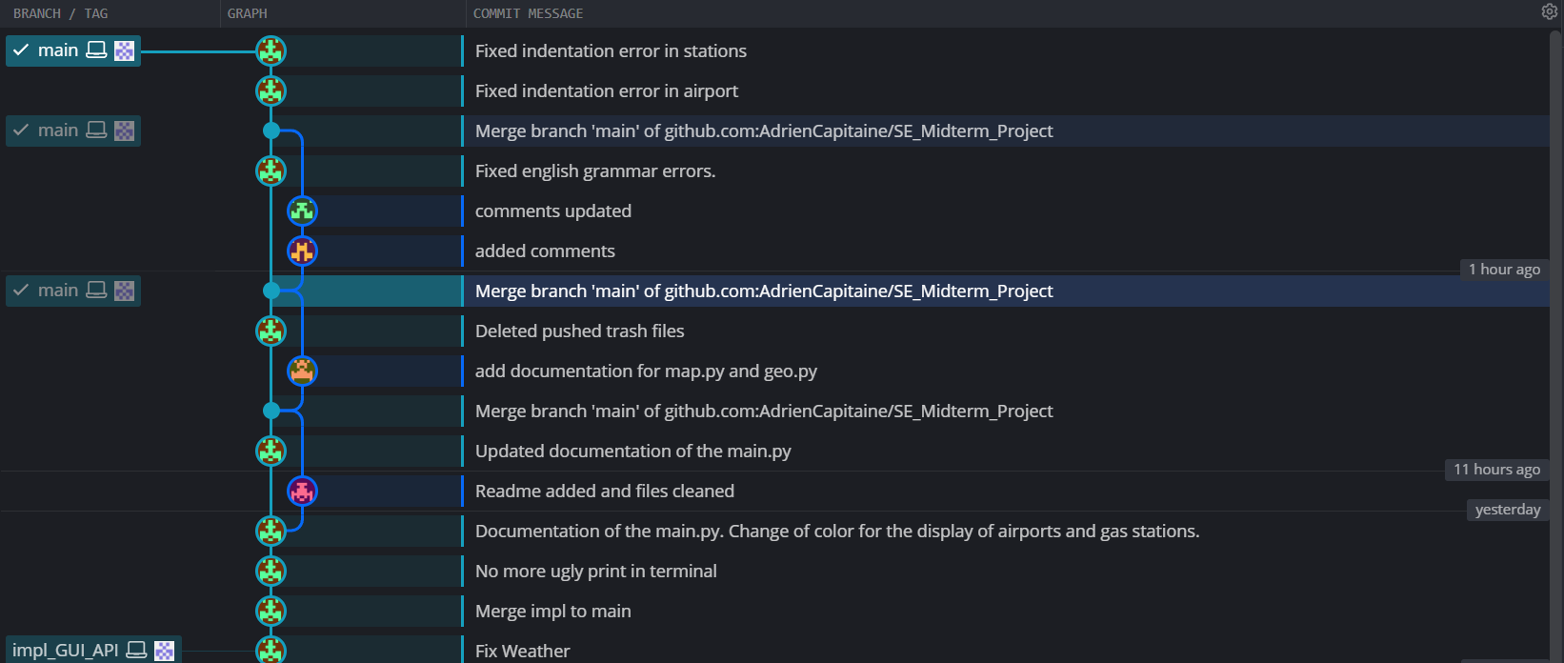
Progress Overview
Git visualisation of our branches and merges

Slide 18
Progress Overview
The workload was divided, so every member contributed evenly to the project:
Adrien handled the UI and UX with custom tkinter
Nathan worked with the graphHopper API to show route and marker in map
Damien handled the airport and gas station call API
Jason handled the weather API and get the time zone of any location
Kelian managed the team by organising meetings and supervised development.
Team learning contribution, problem, solutions, what have we learned

Slide 19

Reflection Points
GUI implementation:
The UI development went smoothly overall. One of the main issues that still isn’t fixed is the text not adapting well to a resize of the app window.
GraphHopper API and Map widget:
The main issue was the integration of a map in a Tkinter GUI. Firstly, we wanted to integrate a web page into the interface, but we failed to find a way to do so. Hence, we found another solution with a map widget that we have adapted.

Slide 20
Reflection Points
Weather API:
For the OpenWeatherMap API, no issue reported. It was pretty smooth and fast to implement.
Gas station API:
Despite efforts, a global API for gas stations was not found. However, an alternative solution was implemented to focus on functionality within the USA. No other issues were encountered.

Slide 21
Reflection Points
Airports API:
The first issue we encountered pertained to understanding the pagination system of the API. Initially, we mistakenly assumed that increasing the offset parameter by one would increase the results by 30. However, this was not the case, resulting in an excessive number of requests to be sent and consequently slowing down the application.
The second issue arose from cities sharing the same name. This led to pulling airports from both cities, causing random airports to be displayed on the map. To address this, we refined the process to only showcase airports within a 50 km radius of the destination city. This was achieved by computing the distance between the airport coordinates and the city using the Haversine formula.
The final problem stemmed from the requirement for users to input the destination city name accurately. The airport API lacks support for autocorrection, necessitating precise city name input for proper airport retrieval.

Slide 22


What have we learned
Thanks to this team project, we have learned how to call various APIs in Python, as well as created a user-friendly interface.

Slide 23
Backlog
Our application can still be improved with a few small adjustments.
In the future, we could :
Show the airport markers only when the airport tab is triggered in order not to overload the map
And same with the gas station
Give the option to the user to show the airport markers near the starting
Use threads to reduce the loading time
Add a dynamic marker update for gas stations in order to update these markers based on user map view.

Slide 24

Thank you for your attention

